Slide 1



Operating System
Prof. Sumitra Menaria, Prof. Uma Bhatt, Assistant Professor Information Technology Department

Slide 2

CHAPTER-2
Processes, Thread & Process Scheduling

Slide 3
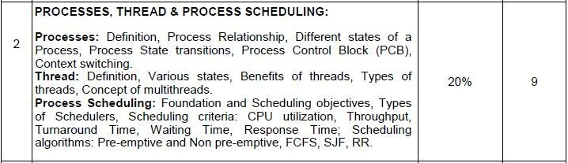
Syllabus

Slide 4
Process
A process is a program in execution.
Process is not as same as program code but a lot more than it.
A process is an 'active' entity as opposed to program which is considered to be a 'passive' entity. Attributes held by process include hardware state, memory, CPU etc.

Slide 5
Main OS Process Related Goals
Interleave the execution of existing processes to maximize processor utilization
Provide reasonable response time
Allocate resources to processes
Support inter-process communication (and synchronization) and user creation of processes

Slide 6
How are these goals achieved ?
Schedule and dispatch processes for execution by the processor
Implement a safe and fair policy for resource allocation to processes
Respond to requests by user programs
Construct and maintain tables for each process managed by the operating system

Slide 7
Process Creation
?When is a new process created
System initialization (Daemons)
Execution of a process creation system call by a running process
A user request to create a process
Initiation of a batch job

Slide 8
Process Termination
?When does a process terminate
Normal exit (voluntary)
Error exit (voluntary)
Fatal error (involuntary)
Killed by another process (involuntary)

Slide 9
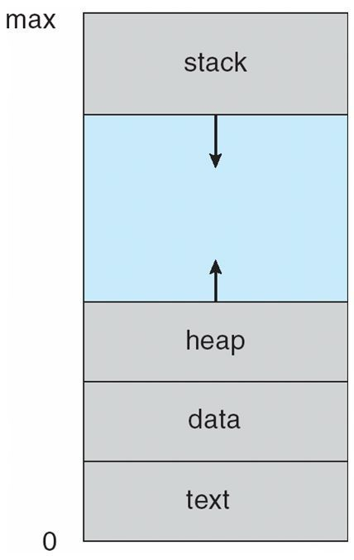
Contd…
Programs are executable(.exe) files generally stored in Secondary Memory.
In order to execute program it must be loaded in main memory.
When a program is loaded into the memory and it becomes process.
Then process memory can be divided into four sections ─ stack, heap, text and data.
Process Stack :Google

Slide 10
Contd..
The Text section is madeup of the compiled program code , read in from non-volatile storage when the program is launched.
The Data section is made up the global and static variables, allocated and initialized prior to executing the main.
The Heap Section is used for the dynamic memory allocation, and is managed via calls to new, delete, malloc, free, etc.
The Stack is used for local variables. Space on the stack is reserved for local variables when they are declared.

Slide 11
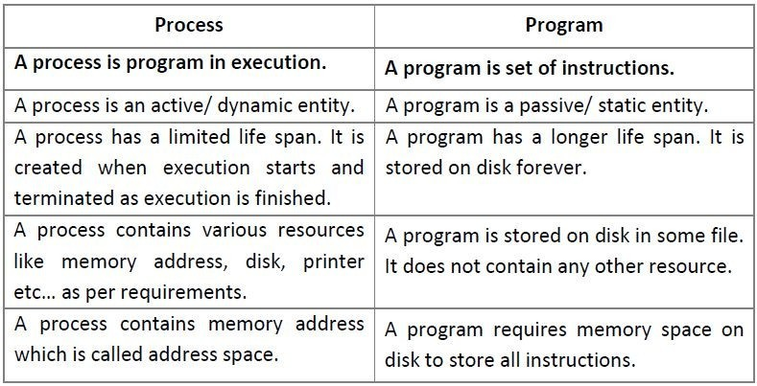
Process Vs. Program

Slide 12
Process State
As a process executes, it changes state.
The state of a process is defined in part by the current activity of that process. The Process state is an indicator of the nature of the current activity in a Process.
Processes in the operating system can be in any of the following states:
¬NEW- The process is being created.
¬READY- The process is waiting to be assigned to a processor.
¬RUNNING- Instructions are being executed.
¬WAITING- The process is waiting for some event to occur(such as an I/O completion or reception of a signal).
¬TERMINATED- The process has finished execution.

Slide 13
Process State & Description
Start
This is the initial state when a process is first started/created.
Ready
The process is waiting to be assigned to a processor. Ready processes are waiting to have the processor allocated to them by the operating system so that they can run.
Process may come into this state after Start state or while running it by but interrupted by the scheduler to assign CPU to some other process.

Slide 14
Contd…
Running
Once the process has been assigned to a processor by the OS scheduler, the process state is set to running and the processor executes its instructions.
Waiting
Process moves into the waiting state if it needs to wait for a resource, such as waiting for user input, or waiting for a file to become available.
For example the process may be waiting for keyboard input, disk access request, inter-process messages, a timer to go off, or a child process to finish.

Slide 15
Contd..
Terminated or Exit
Once the process finishes its execution, or it is terminated by the operating system, it is moved to the terminated state where it waits to be removed from main memory.

Slide 16
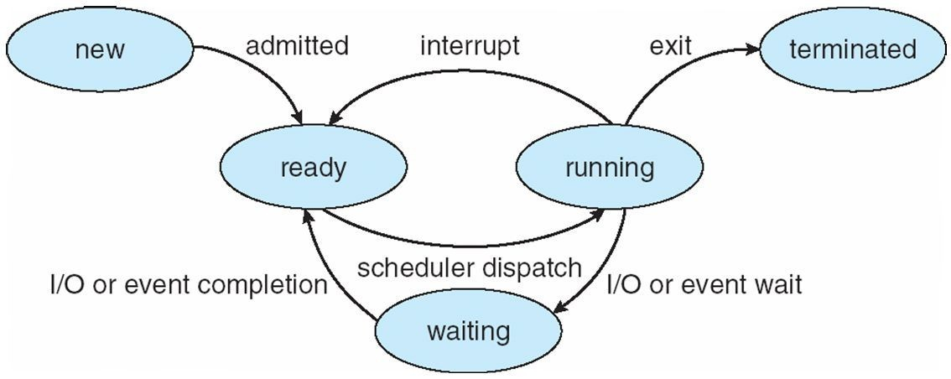
Process State Transitions
Process State^{[ 1 ]}

Slide 17
Process Transitions
Ready --> Running
When it is time, the dispatcher selects a new process to run
Running --> Ready
the running process has expired his time slot the running process gets interrupted because a higher priority process is in the ready state

Slide 18

Contd…
Running --> Blocked
When a process requests something for which it must wait
a service that the OS is not ready to perform an access to a resource not yet available initiates I/O and must wait for the result waiting for a process to provide input (IPC).
Blocked --> Ready
When the event for which it was waiting occurs

Slide 19
Process Suspension
Many OS are built around (Ready, Running, Blocked) states. But there is one more state that may aid in the operation of an OS - suspended state.
When none of the processes occupying the main memory is in a Ready state, OS swaps one of the blocked processes out onto to the Suspend queue.
When a Suspended process is ready to run it moves into “Ready, Suspend” queue. Thus we have two more state: Blocked_Suspend, Ready_Suspend.

Slide 20
Contd…
Blocked_suspend: The process is in the secondary memory and awaiting an event.
Ready_suspend: The process is in the secondary memory but is available for execution as soon as it is loaded into the main memory.
Observe on what condition does a state transition take place? What are the possible state transitions?

Slide 21

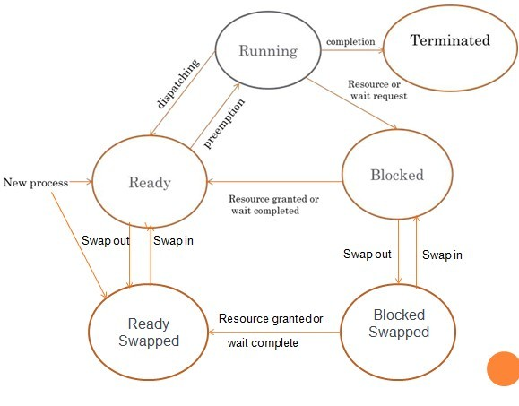
Process Suspension : Google

Slide 22
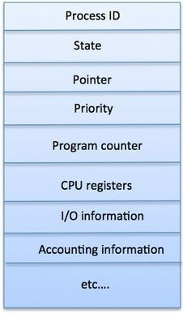
Process Control Block
A Process Control Block is a data structure maintained by the Operating System for every process.
The PCB is identified by an integer process ID (PID).
A PCB keeps all the information needed to keep track of a process
Process Control Block :Google

Slide 23
Contd…
1 | Process State : The current state of the process i.e., whether it is ready, running, waiting, or whatever.
2 | Process privileges : This is required to allow/disallow access to system resources.
3 | Process ID : Unique identification for each of the process in the operating system.
4 | Pointer : A pointer to parent process.
Table : 2.1 Process States Attributes

Slide 24
Contd…
5 | Program Counter : Program Counter is a pointer to the address of the next instruction to be executed for this process.
6 | CPU registers : Various CPU registers where process need to be stored for execution for running state.
7 | CPU Scheduling Information : Process priority and other scheduling information which is required to schedule the process.
8 | Memory management information :information of page table, memory limits, Segment table depending on memory used by the OS
9 | Accounting information :This includes the amount of CPU used for process execution, time limits, execution ID etc.
10 | IO status information : list of I/O devices allocated to the process.
Table : 2.2 Process States Attributes

Slide 25
Contd…
The PCB is maintained for a process throughout its lifetime, and is deleted once the process terminates.

Slide 26
Context Switching
Switching the CPU to another process requires saving the state of the old process and loading the saved state for the new process. This task is known as a Context Switch.
A context switch is a procedure that a computer's CPU (central processing unit) follows to change from one task (or process) to another while ensuring that the tasks do not conflict.
Effective context switching is critical if a computer is to provide user-friendly multitasking.

Slide 27
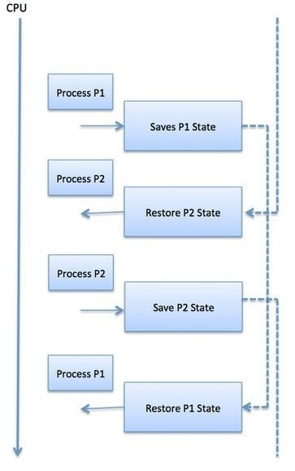
Example
Context Switch : Google

Slide 28
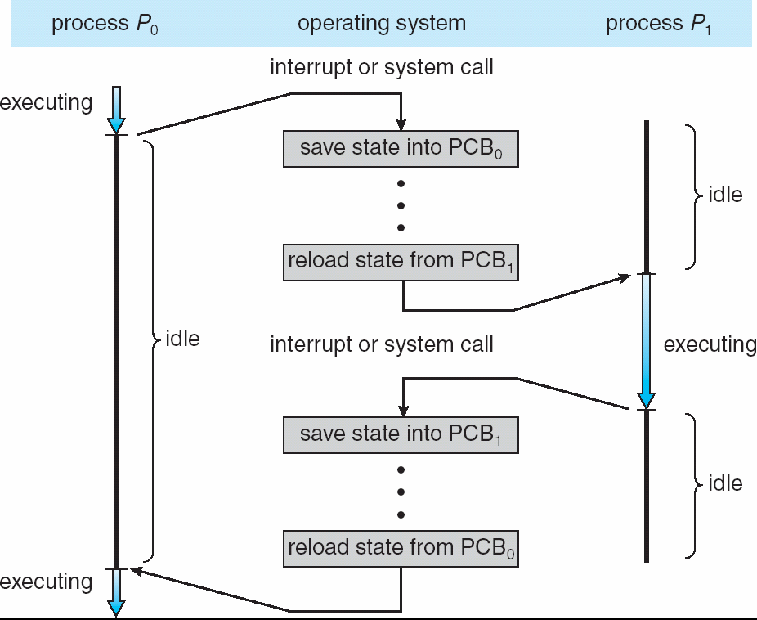
Example
CPU Switch from Process to Process ^{[1]}

Slide 29
Contd…
A context switch is the mechanism to store and restore the state or context of a CPU in Process Control block so that a process execution can be resumed from the same point at a later time.
Using this technique, a context switcher enables multiple processes to share a single CPU. Context switching is an essential part of a multitasking operating system features.

Slide 30
Contd…
Context switch time is pure overhead, because the system does no useful work while switching.
Context Switching has become such a performance bottleneck that programmers are using new structures(threads) to avoid it whenever and wherever possible.

Slide 31
Thread
A thread is a single sequence stream within a process.
They are sometimes called lightweight processes.
In a process, threads allow multiple executions of streams.
Thread is an execution unit which consists of its own program counter, a stack, and a set of registers.
As each thread has its own independent resource for process execution, multiple processes can be executed parallel by increasing number of threads.
Each thread belongs to exactly one process and no thread can exist outside a process.

Slide 32
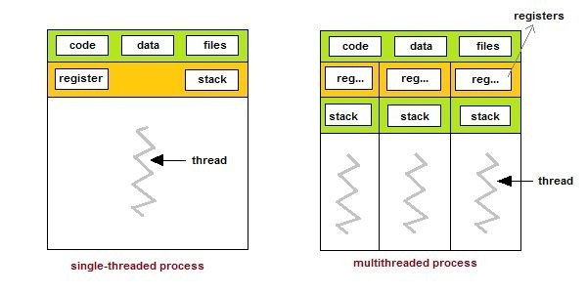
Threads
Single and Multithreaded Processes ^{[1]}

Slide 33
Advantages of Thread
Threads minimize the context switching time.
Use of threads provides concurrency within a process.
Efficient communication.
It is more economical to create and context switch threads.
Threads allow utilization of multiprocessor architectures to a greater scale and efficiency.

Slide 34
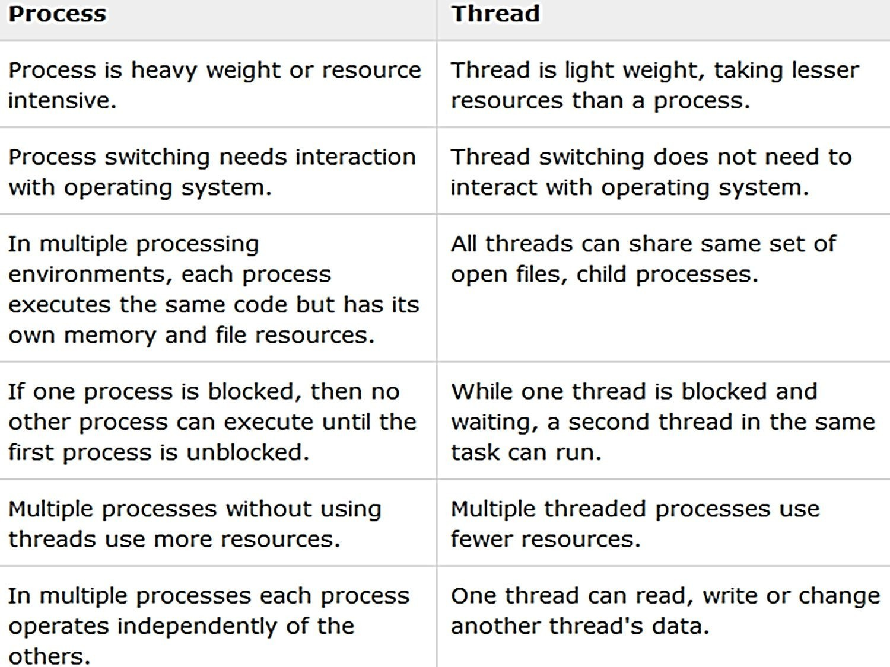
Process Vs. Thread

Slide 35
Types of Thread
User Level Threads − User managed threads.
Kernel Level Threads − Operating System managed threads acting on kernel, an operating system core.

Slide 36
User Level Thread
•
In this case, the thread management kernel is not aware of the existence of threads.
•
The thread library contains code for creating and destroying
threads, for passing message and data between threads, for scheduling thread execution and for saving and restoring thread contexts.
•
The application starts with a single thread.

Slide 37
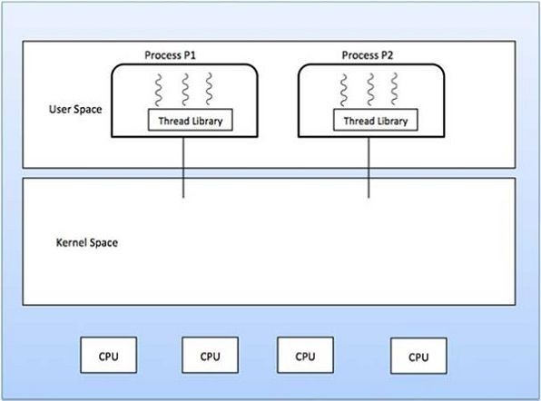
Contd…
User Level Thread :Google

Slide 38
Advantages and Disadvantages
Advantages
•
•
•
•
Thread switching does not require Kernel mode privileges. User level thread can run on any operating system.
Scheduling can be application specific in the user level thread. User level threads are fast to create and manage.
Disadvantages
Multithreaded application cannot take advantage of multiprocessing

Slide 39
Kernel Level Thread
In this case, thread management is done by the Kernel.
There is no thread management code in the application area.
Kernel threads are supported directly by the operating system.
The Kernel performs thread creation, scheduling and management in Kernel space.

Slide 40
Advantages
Kernel can simultaneously schedule multiple threads from the same process on multiple processes.
If one thread in a process is blocked, the Kernel can schedule another thread of the same process.

Slide 41
Disadvantages
Kernel threads are generally slower to create and manage than the user threads.
Transfer of control from one thread to another within the same process requires a mode switch to the Kernel.

Slide 42
Multithreading
Ability of operating system to execute multiple threads.
Some operating system provide a combined user level thread and Kernel level thread facility.
Multithreading Models
Many to One Model
One to One Model
Many to Many Model

Slide 43
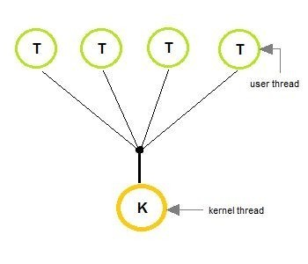
Many to one Model
In the many to one model, many user-level threads are all mapped onto a single kernel thread.
Thread management is handled by the thread library in user space, which is efficient in nature
.
Many to One Model ^{[1]}

Slide 44
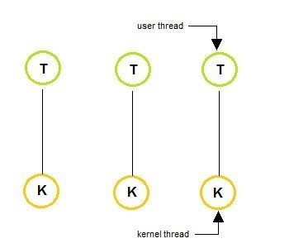
One to One Model
The one to one model creates a separate kernel thread to handle each and every user thread.
Most implementations of this model place a limit on how many threads can be created.
Linux and Windows from 95 to XP implement the one-to-one model for threads
One to One Model ^{[1]}

Slide 45
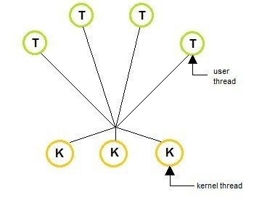
Many to Many Model
The many to many model multiplexes any number of user threads onto an equal or smaller number of kernel threads, combining the best features
of the one-to-one and many-to-one models.
Users can create any number of the threads.
Blocking the kernel system calls does not block the entire process.
Processes can be split across multiple processors.
Many to Many Model^{[1]}

Slide 46
Benefits of Multithreading
Responsiveness
Resource sharing, hence allowing better utilization of resources.
Economy: Creating and managing threads becomes easier.
Scalability: One thread runs on one CPU. In Multithreaded processes, threads can be distributed over a series of processors to scale.
Context Switching is smooth. Context switching refers to the procedure followed by CPU to change from one task to another.

Slide 47
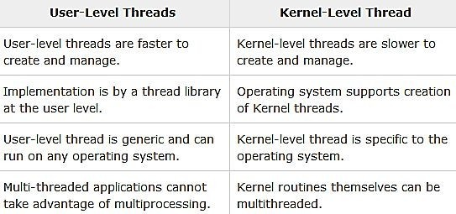
User Level Thread Vs. Kernel Level Thread

Slide 48






What is process scheduling?
The act of determining which process is in the ready state, and should be moved to the running state is known as Process Scheduling”
NEW
TERMINA TED
^{ADMITT}ED
INTERRUPT
EXIT
RUNNIN G
READY
SCHEDULAR DISPATCH
^{I/O OR EVE}NT
I/O ^{OR EVENT}
^{COMPLETI}ON
WAITING
WAI^{T}
Process Scheduling^{[1]}

Slide 49







Why process scheduling?
Bill desk
CPU
Although another desk is available people are waiting for their turn
Bill desk for senior citizens
Billing desk is empty, and can handle other tasks
CPU

Slide 50
Why process scheduling?
The prime aim of the process scheduling system is:
to keep the CPU busy all the time
to deliver minimum response time for all programs
Bill desk
Bill desk(priority to senior citizens)

Slide 51
About process scheduling
The scheduler must apply appropriate rules for swapping processes IN and OUT of CPU
Process scheduling is a process which allows one process to use the CPU while the execution of another process is on hold(in waiting state) due to unavailability of any resource like I/O etc, thereby making full use of CPU
.
The aim of CPU scheduling is to make the system efficient, fast and fair.

Slide 52
Types of Scheduling
Scheduling can be of two types:
Non Pre-emptive Scheduling: When the currently executing process gives up the CPU voluntarily.
Pre-emptive Scheduling: When the operating system decides to favour another process, pre-empting the currently executing process.

Slide 53
Non Pre-emptive Scheduling
JOB’S IN READY QUEUE
JOB IN EXECUTION
CPU
Billing Desk

Slide 54
Non Pre-emptive Scheduling
JOB’S IN READY QUEUE
JOB IN EXECUTION
CPU
All jobs in ready queue has to wait till Job in execution completes its task.

Slide 55
Pre-emptive Scheduling
JOB’S IN READY QUEUE
JOB IN EXECUTION
priority
CPU
Billing Desk

Slide 56
Pre-emptive Scheduling
JOB’S IN READY QUEUE
JOB IN EXECUTION
priority
CPU
operating system decides to favour another process, pre-empting the currently executing process

Slide 57
Scheduling Queues
All processes, upon entering into the system, are stored in the Job Queue.
Processes in the Ready state are placed in the Ready Queue.
Processes waiting for a device to become available are placed in Device Queues. There are unique device queues available for each I/O device.
A new process is initially put in the Ready queue. It waits in the ready queue until it is selected for execution(or dispatched).

Slide 58
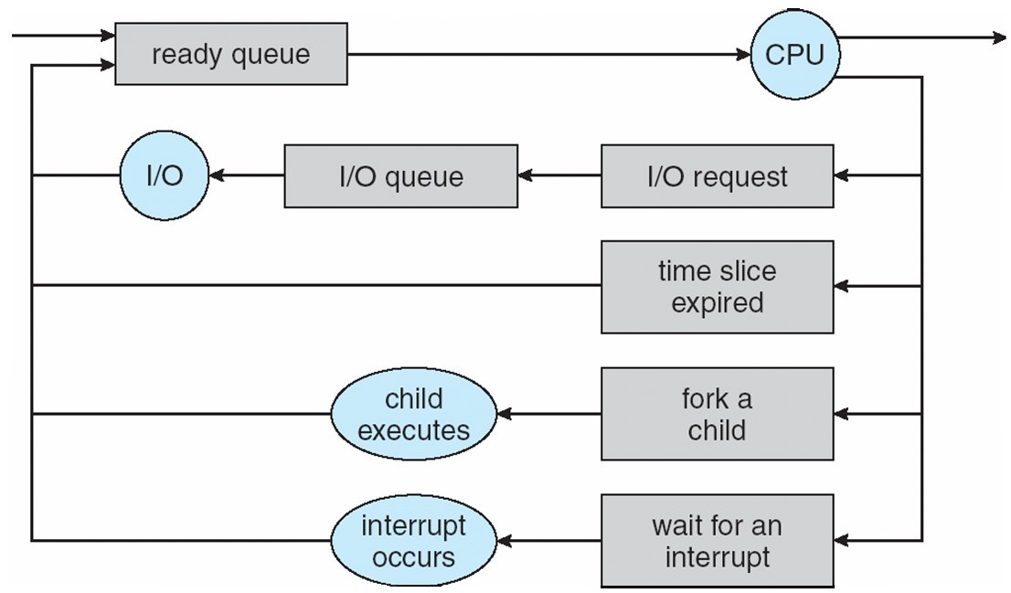
Scheduling Queues
Scheduling Queues ^{[1]}

Slide 59
Scheduling Queues
Once the process is assigned to the CPU and is executing, one of the following several events can occur:
1.The process could issue an I/O request, and then be placed in the I/O queue. 2.The process could create a new sub process and wait for its termination.
3.The process could be removed forcibly from the CPU, as a result of an interrupt, and be put back in the ready queue.
In the first two cases, the process eventually switches from the waiting state to the ready state, and is then put back in the ready queue.
A process continues this cycle until it terminates, at which time it is removed from all queues and has its PCB and resources deallocated.

Slide 60



Types of Schedulers
Schedulers
Long Term Scheduler
Short Term
Scheduler
Medium Term Scheduler

Slide 61
Long Term Scheduler
Long term scheduler runs less frequently.
Long Term Schedulers decide which program must get into the job queue.
From the job queue, the Job Processor, selects processes and loads them into the memory for execution.
Primary aim of the Job Scheduler is to maintain a good degree of Multiprogramming

Slide 62
Short Term Scheduler
•
This is also known as CPU Scheduler and runs very frequently.
•
The primary aim of this scheduler is to enhance CPU performance and increase process execution rate.

Slide 63
Medium Term Scheduler
•
During extra load, this scheduler picks out big processes from the ready queue for some time, to allow smaller processes to execute, thereby reducing the number of processes in the ready queue.
•
At some later time, the process can be reintroduced into memory and its execution can be continued where it left off. This scheme is called swapping

Slide 64
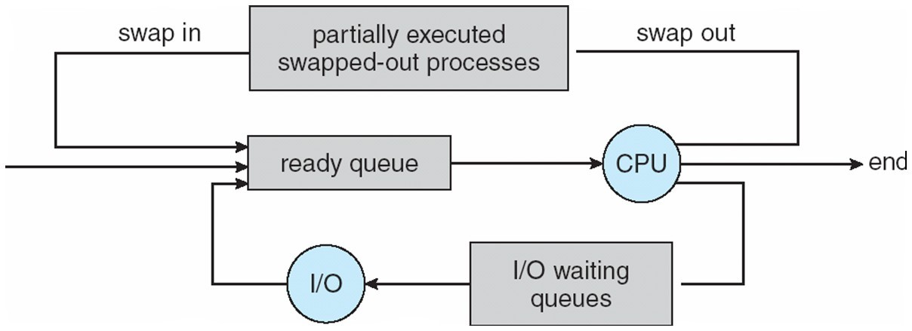
Medium Term Scheduler
Medium Term Scheduler ^{[1]}

Slide 65
Scheduling Criteria
1. CPU utilization
To make out the best use of CPU and not to waste any CPU cycle, CPU would be working most of the time(Ideally 100% of the time).
Considering a real system, CPU usage should range from 40% (lightly loaded) to 90% (heavily loaded.)
•
•
2. Throughput
It is the total number of processes completed per unit time or rather say total amount of work done in a unit of time.
This may range from 10/second to 1/hour depending on the specific processes.
•
•

Slide 66
Scheduling Criteria
Turnaround time
It is the amount of time taken to execute a particular process, i.e. The interval from time of submission of the process to the time of completion of the process(Wall clock time).
Waiting time
The sum of the periods spent waiting in the ready queue amount of time a process has been waiting in the ready queue to acquire get control on the CPU.

Slide 67
Scheduling Criteria
5. Load average
It is the average number of processes residing in the ready queue waiting for their turn to get into the CPU.
6. Response time
Amount of time it takes from when a request was submitted until the first response is produced.

Slide 68
Operation on Process
Process Creation:
The process which creates other process, is termed the parent of the other process, while the created sub-process is termed its child.
Each process is given an integer identifier, termed as process identifier, or PID.
The parent PID (PPID) is also stored for each process.
Process Termination:
By making the exit(system call), processes may request their own termination.

Slide 69
CPU Scheduling
CPU scheduling is a process which allows one process to use the CPU while the execution of another process is on hold(in waiting state) due to unavailability of any resource like I/O etc, thereby making full use of CPU.
The aim of CPU scheduling is to make the system efficient, fast and fair.
Whenever the CPU becomes idle, the operating system must select one of the processes in the ready queue to be executed.
The selection process is carried out by the short-term scheduler (or CPU scheduler). The scheduler selects from among the processes in memory that are ready to execute, and allocates the CPU to one of them.

Slide 70




Scheduling Algorithms
To decide which process to execute first and which process to
execute last to achieve maximum CPU utilization, computer scientists have defined some algorithms, they are:
First Come First Serve(FCFS) Scheduling
Shortest-Job-First(SJF) Scheduling
Priority Scheduling
Round Robin(RR) Scheduling
Multilevel Queue Scheduling
Multilevel Feedback Queue Scheduling

Slide 71
First Come First Serve(FCFS) Scheduling
In the "First come first serve" scheduling algorithm, as the name suggests, the process which arrives first, gets executed first, or we can say that the process which requests the CPU first, gets the CPU allocated first.
First Come First Serve, is just like FIFO(First in First out) Queue data structure, where the data element which is added to the queue first, is the one who leaves the queue first.
This is used in Batch Systems.

Slide 72
First Come First Serve(FCFS) Scheduling
It's easy to understand and implement programmatically, using a Queue data structure, where a new process enters through the tail of the queue, and the scheduler selects process from the head of the queue.
A perfect real life example of FCFS scheduling is buying tickets at ticket counter.

Slide 73
First Come First Serve(FCFS) Scheduling
¬Calculating Average Waiting Time
For every scheduling algorithm, Average waiting time is a crucial parameter to judge it's performance.
AWT or Average waiting time is the average of the waiting times of the processes in the queue, waiting for the scheduler to pick them for execution.
Lower the Average Waiting Time, better the scheduling algorithm

Slide 74
FCFS: Example
Consider the processes P1, P2, P3, P4 given in the below table, arrives for execution in the same order, with Arrival Time 0, and given Burst Time.
PROCESS | BURST TIME
P1 | 21
P2 | 3
P3 | 6
P4 | 2

Slide 75

FCFS: Example
The average waiting time will be = (0+21+24+30)/4
=18.75 ms
PROCESS | BURST TIME
P1 | 21
P2 | 3
P3 | 6
P4 | 2
GANTT chart for above process

Slide 76

FCFS: Example
PROCESS | ARRIVAL TIME | BURST TIME | COMPLETI ON TIME | TAT (CT-AT) | WT (TAT-BT) | RESPONSE TIME
P1 | 0 | 21 | 21 | 21 | 0 | 0
P2 | 0 | 3 | 24 | 24 | 21 | 21
P3 | 0 | 6 | 30 | 30 | 24 | 24
P4 | 0 | 2 | 32 | 32 | 30 | 30
JOB IN EXECUTION
232321312574321689102987654310140892356
Ready queue

Slide 77
FCFS: Example
Consider the processes P1, P2, P3, P4 given in the below table, arrives for execution in the same order, with different Arrival Time, and given Burst Time.
PROCESS | ARRIVAL TIME | BURST TIME
P1 | 0 | 2
P2 | 1 | 2
P3 | 5 | 3
P4 | 6 | 4

Slide 78

FCFS: Example
PROCESS | ARRIVAL TIME | BURST TIME | COMPLETI ON TIME | TAT (CT-AT) | WT (TAT-BT) | RESPONSE TIME
P1 | 0 | 2 | 2 | 2 | 0 | 0
P2 | 1 | 2 | 4 | 3 | 1 | 21
P3 | 5 | 3 | 8 | 3 | 0 | 24
P4 | 6 | 4 | 12 | 6 | 2 | 30
JOB IN EXECUTION
18765432019210
Ready queue

Slide 79
Problems in FCFS
It is Non Pre-emptive algorithm, which means the process priority doesn't matter.
Not optimal Average Waiting Time.
Resources utilization in parallel is not possible, which leads
to Convoy Effect, and hence poor resource(CPU, I/O etc) utilization.
¬Convoy Effect: Convoy Effect is a situation where many processes, who need to use a resource for short time are blocked by one process holding that resource for a long time.
This essentially leads to poor utilization of resources and hence poor performance.

Slide 80
The average waiting time will be 18.75 ms
For the above given processes, first P1 will be provided with the CPU resources,
Hence, waiting time for P1 will be 0
P1 requires 21 ms for completion, hence waiting time for P2 will be 21 ms
Similarly, waiting time for process P3 will be execution time of P1 + execution time for P2, which will be (21 + 3) ms = 24 ms.
For process P4 it will be the sum of execution times of P1, P2 and P3.
In which order if processes comes then average waiting time will be lesser?

Slide 81
Shortest Job First(SJF) Scheduling
Shortest Job First scheduling works on the process with the shortest burst time or duration first.
It is of two types:
Non Pre-emptive
Pre-emptive
To successfully implement it, the burst time/duration time of the processes should be known to the processor in advance, which is practically not feasible all the time.
This scheduling algorithm is optimal if all the jobs/processes are available at the same time. (either Arrival time is 0 for all, or Arrival time is same for all)

Slide 82
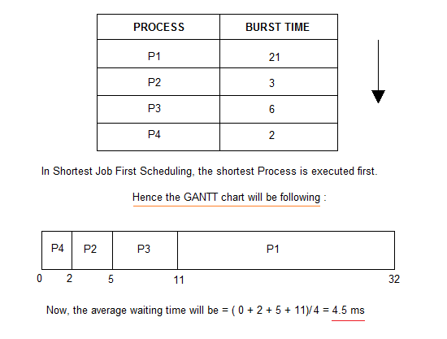
Non Pre-emptive SJF
Consider the below processes available in the ready queue for execution, with arrival time as 0 for all and given burst times.
Based on FCFS what’s Avg. waiting time = 18.75ms

Slide 83
¬Problems with Non pre-emptive SJF:
If the arrival time for processes are different, which means all the processes are not available in the ready queue at time 0, and some jobs arrive after some time, in such situation, sometimes process with short burst time have to wait for the current process's execution to finish, because in Non Pre-emptive SJF, on arrival of a process with short duration, the existing job/process's execution is not halted/stopped to execute the short job first.
This leads to the problem of Starvation, where a shorter process has to wait for a long time until the current longer process gets executed.

Slide 84
Pre-emptive SJF
In Preemptive Shortest Job First Scheduling, jobs are put into ready queue as they arrive, but as a process with short burst time arrives, the existing process is preempted or removed from execution, and the shorter job is executed first.

Slide 85
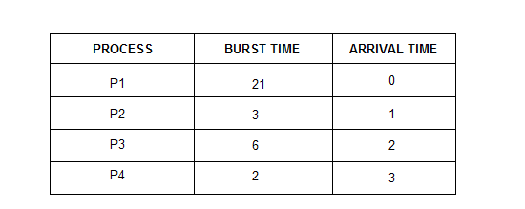
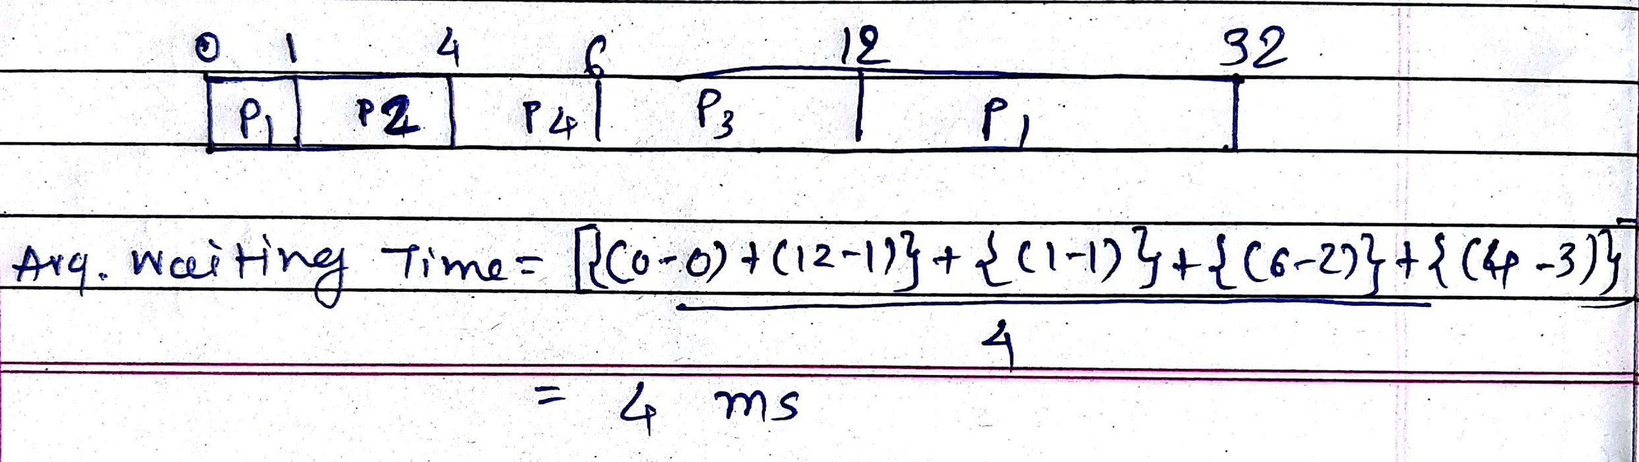

Slide 86
Priority Scheduling
Priority is assigned for each process.
Process with highest priority is executed first and so on.
Processes with same priority are executed in FCFS manner.
Priority can be decided based on memory requirements, time requirements or any other resource requirement.
Pre-emptive: Preempt the CPU if the priority of newly arrived process is higher than the priority of the currently running process.
Nonpreemptive: It will simply put the new process at the head of the ready queue.

Slide 87
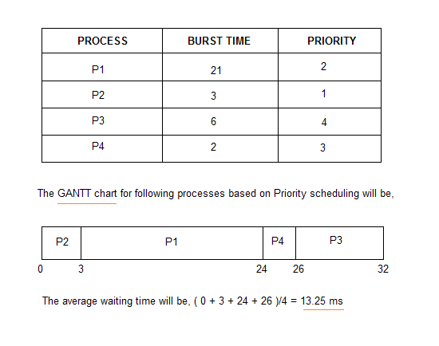

Slide 88
Problem:
Indefinite Blocking/Starvation ◊ In heavily loaded systems with High-priority processes some low priority processes are blocked because of high number of high- priority processes, so low priority process will be waiting indefinitely.
Solution:
Aging◊ Gradually increase the priority of processes that wait in the system for a long time.

Slide 89
Round Robin Scheduling
Each process gets a small unit of CPU time (time quantum q),
usually 10-100 milliseconds. After this time has elapsed, the
process is preempted and added to the end of the ready queue.
Context switching is used to save states of preempted processes.
If there are n processes in the ready queue and the time quantum is q, then each process gets 1/n of the CPU time in chunks of at most q time units at once. No process waits more than (n-1)q time units.
Timer interrupts every quantum to schedule next process

Slide 90
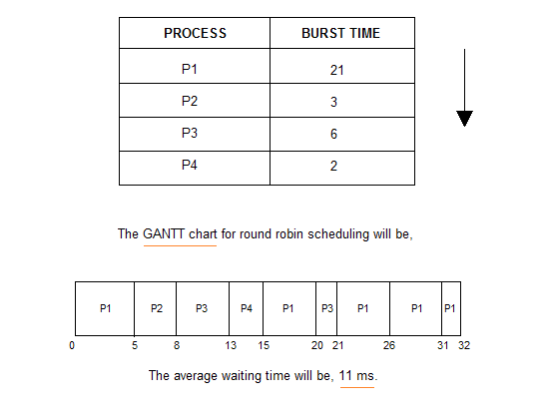
Time Quantum (q) = 5

Slide 91
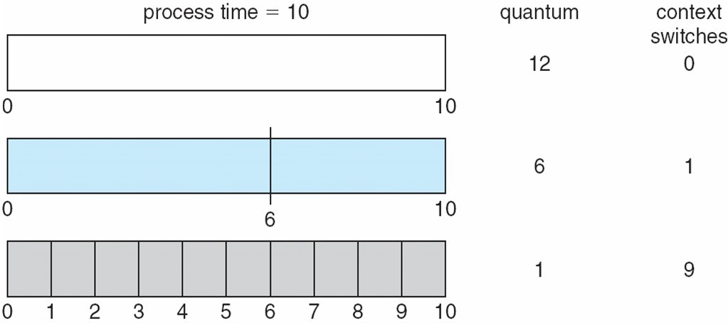
Performance
q large ⇒ FIFO
q small ⇒ q must be large with respect to context switch, otherwise overhead is too high
q should be large compared to context switch time
q usually 10ms to 100ms, context switch < 10 μsec

Slide 92
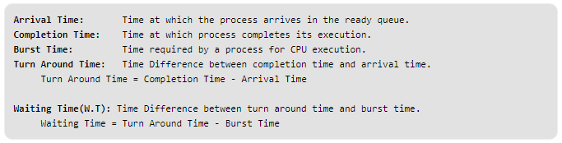
Response Time = Start Time of Process – Arrival Time

Slide 93
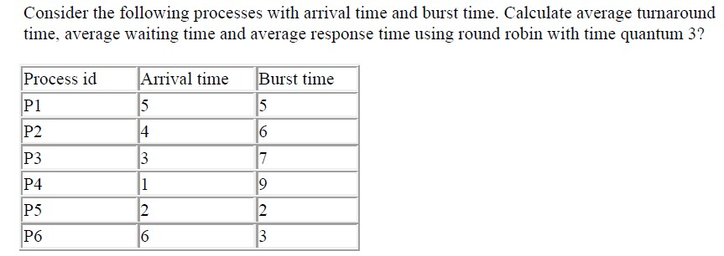

Slide 94
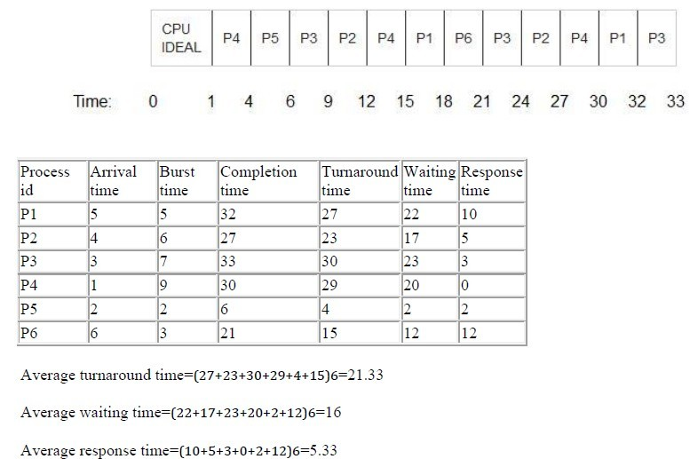

Slide 95
Multilevel Queue Scheduling
A multi-level queue scheduling algorithm partitions the ready queue into several separate queues.
foreground (interactive)
background (batch)
The processes are permanently assigned to one queue, generally based on some property of the process, such as memory size, process priority, or process type.
Each queue has its own scheduling algorithm.
foreground – RR
background – FCFS
In addition, there must be scheduling among the queues, which is commonly implemented as fixed-priority pre-emptive scheduling.

Slide 96
Each queue has absolute priority over lower-priority queues. No process in the batch queue, for example, could run unless the queues for system processes, interactive processes, and interactive editing processes were all empty.
If an interactive editing process entered the ready queue while a batch process was running, the batch process will be pre-empted.

Slide 97
Multilevel Feedback Queue Scheduling
This Scheduling is like Multilevel Queue(MLQ) Scheduling but in this process can move between the queues. Multilevel Feedback Queue Scheduling (MLFQ) keep analysing the behaviour (time of execution) of processes and according to which it changes its priority.
Multilevel-feedback-queue scheduler defined by the following parameters:
number of queues
scheduling algorithms for each queue
method used to determine when to upgrade a process
method used to determine when to demote a process
method used to determine which queue a process will enter when that process needs service

Slide 98
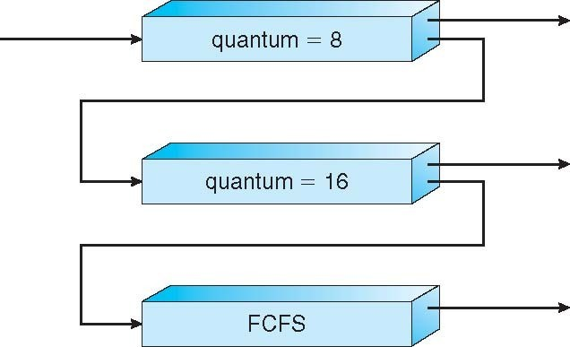
Multilevel Feedback Queues

Slide 99
Three queues:
Q₀ – RR with time quantum 8 milliseconds
Q₁ – RR time quantum 16 milliseconds
Q₂ – FCFS
Scheduling
A new job enters queue Q₀ which is served FCFS
When it gains CPU, job receives 8 milliseconds
If it does not finish in 8 milliseconds, job is moved to queue Q₁
At Q₁ job is again served FCFS and receives 16 additional milliseconds
If it still does not complete, it is preempted and moved to queue Q₂

Slide 100
References
Silberschatz, A., Galvin, P. B., & Gagne, G. (2005). Operating system concepts. Hoboken, NJ: J. Wiley & Sons.
Stallings, W. (2018). Operating systems: Internals and design principles.
Prentice-Hall
Tanenbaum, A. (2014). Modern operating systems. Harlow: Pearson.
Nutt, G. J. (2004). Operating systems: A modern perspective. Boston: Pearson/ Addison Wesley.
Bower T. Operating System Structure. K–State Polytechnic. http://faculty.salina.k-state.edu/tim/ossg/Introduction/struct.html
Bower T. Basic Operating System Concepts. K–State Polytechnic. http://faculty.salina.k-state.edu/tim/ossg/Introduction/OSrole.html
Operating System Generations. Tutorialspoint. https://www.tutorialspoint.com/operating-system-generations

Slide 101


www.paruluniversity.ac.in

